Slide 1
Understanding solar panel adoption using the DeepSolar++ dataset
Alanoud Alhakbani, Luca Montanelli, and Mahmoud Ramadan

Slide 2
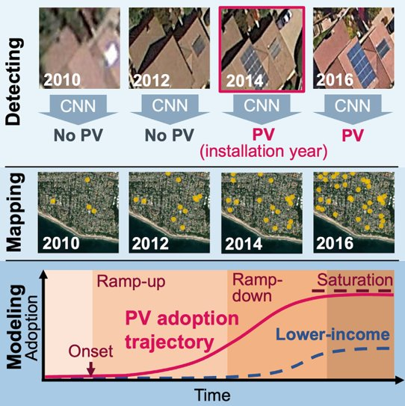
DeepSolar++ dataset​
Simple explanation of paper​
  Created a CNN to extract solar panel numbers per county for many years​
  Fitted a Bass model of technology adoption​
Explain what features we have in our data​

Slide 3
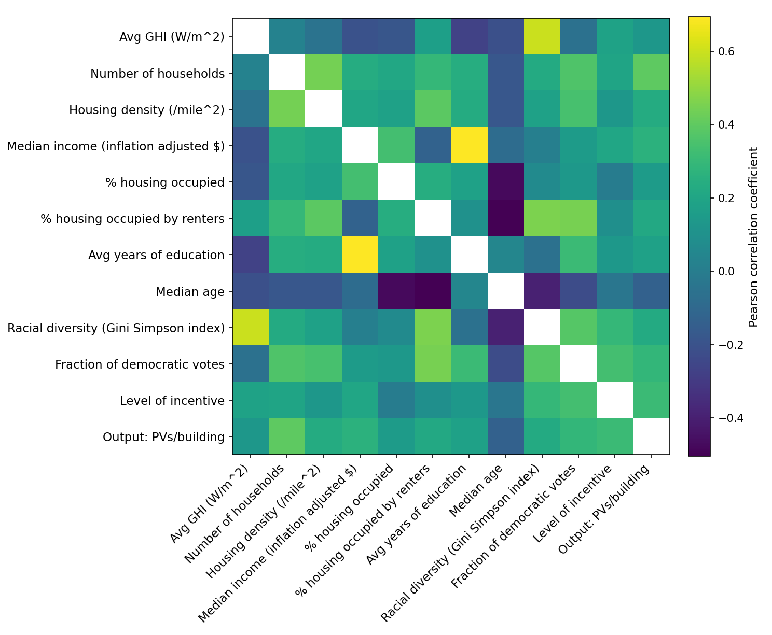
Data exploration
Correlation plot
Clustered time series
Clustered states

Slide 4
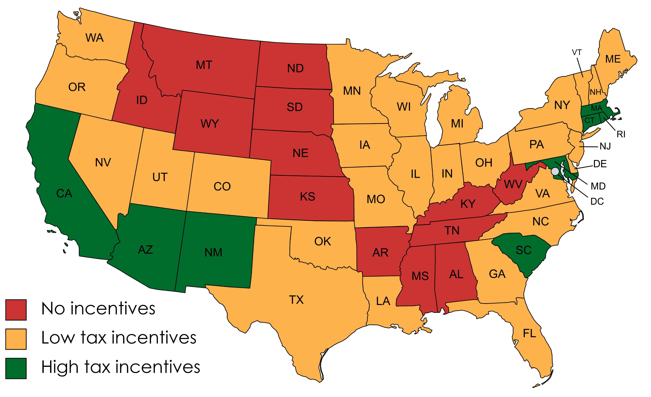
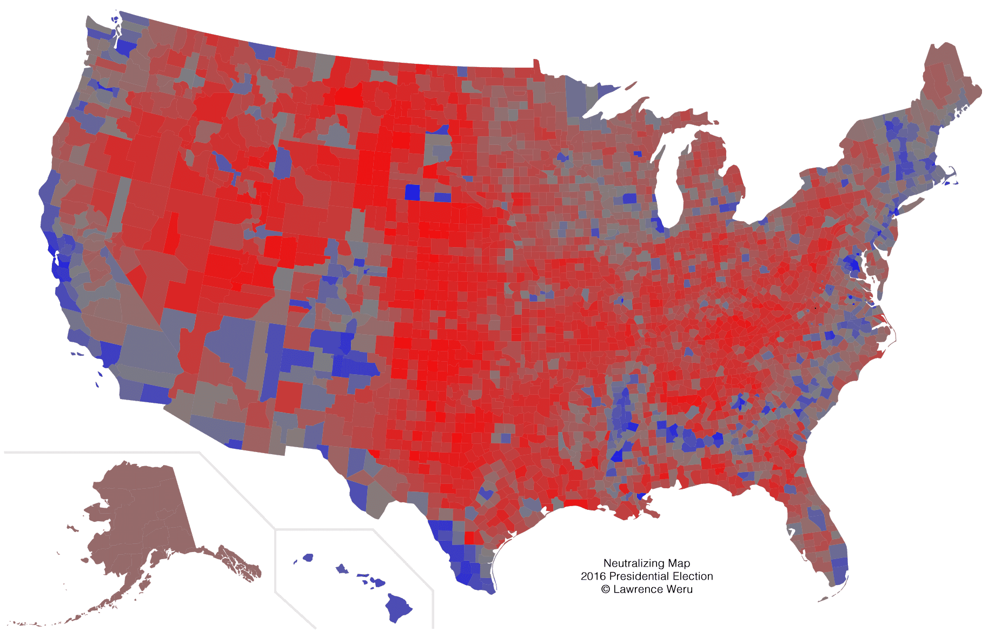
Additional features
Votes map
Incentives map
  With explanation of what those are

Slide 5
Preliminary model scoring
Simple testing of different models to see where to focus​
Decided to investigate RandomForest, GradientBoosting, and NN more deeply
 | Lasso | Ridge | RandomForest | GradientBoosting | XGBoost | NN
Without state features | 0.1770 | 0.1796 | 0.3075 | 0.2124 | 0.3566 | 0.2806
With state feature | 0.6550 | 0.6347 | 0.7232 | 0.6932 | 0.7079 | 0.5524
Only y>0 | 0.4963 | 0.4899 | 0.7106 | 0.7532 | 0.8100 | 0.7033

Slide 6
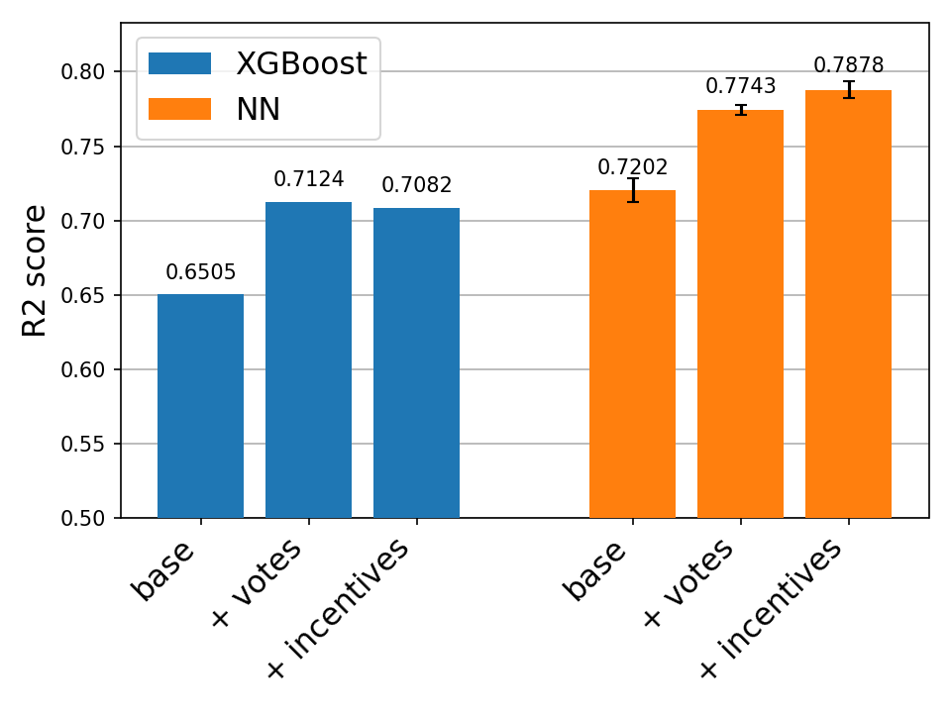
Hyperparameter tuning​
Performed Bayesian optimisation with cross-validation to find the best hyperparameters​
RandomForest:​
  Did not perform better than previously​
XGBoost:​
  Performed best with add vote feature​
NN:​
  Simple fully connected layers
  Best performing model​

Slide 7
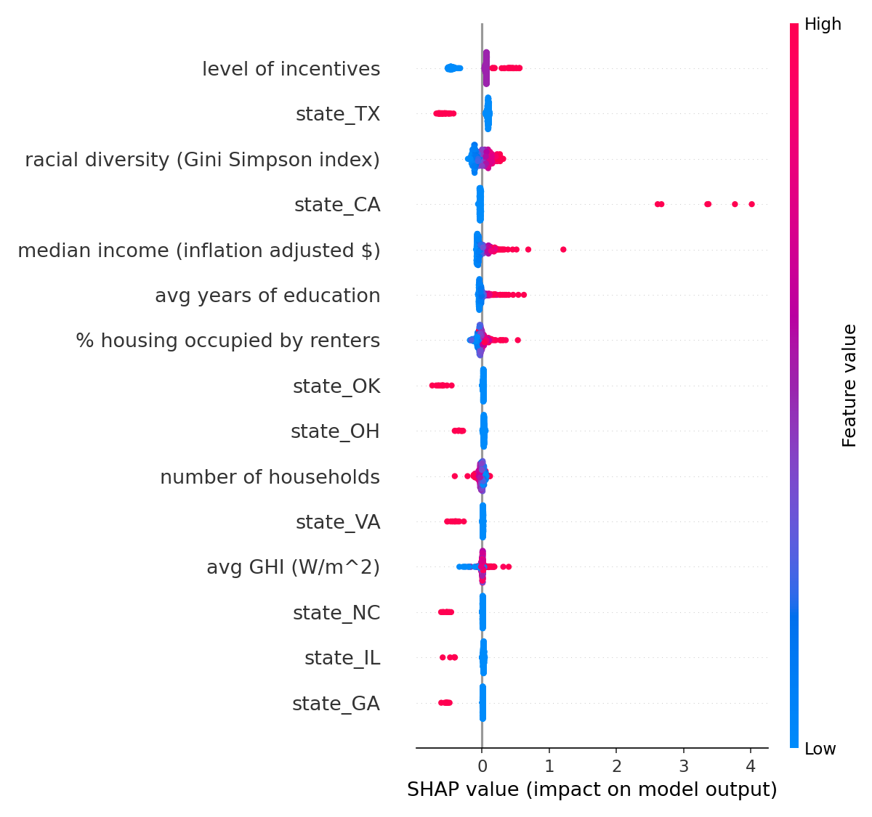
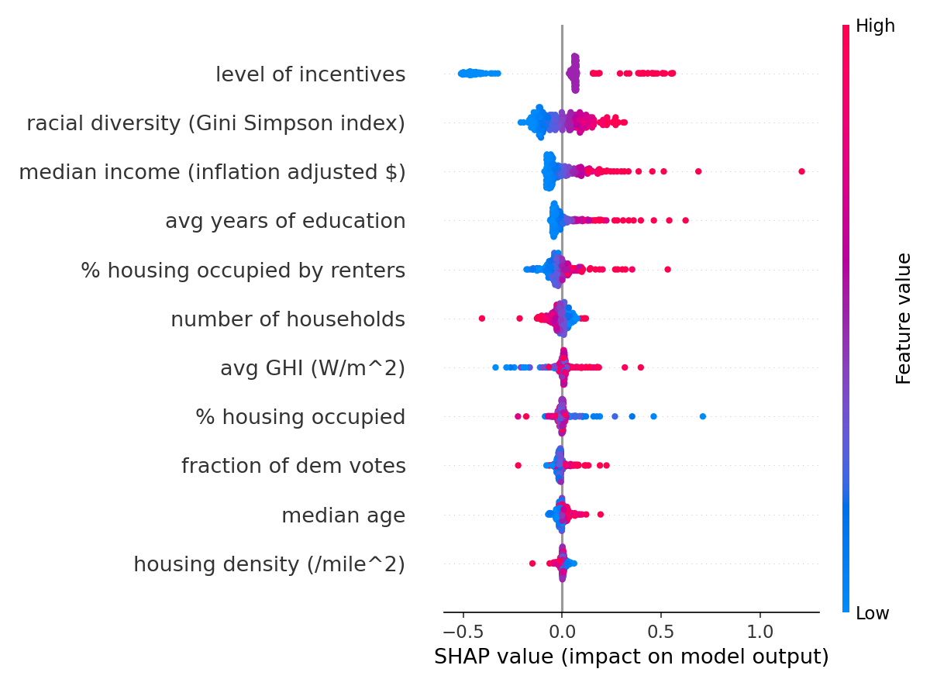
Interpretability
SHAP values were used to interpret the output of the best NN​
SHAP values are based on cooperative game theory​
They provide interpretability for hard to explain models​

Slide 8
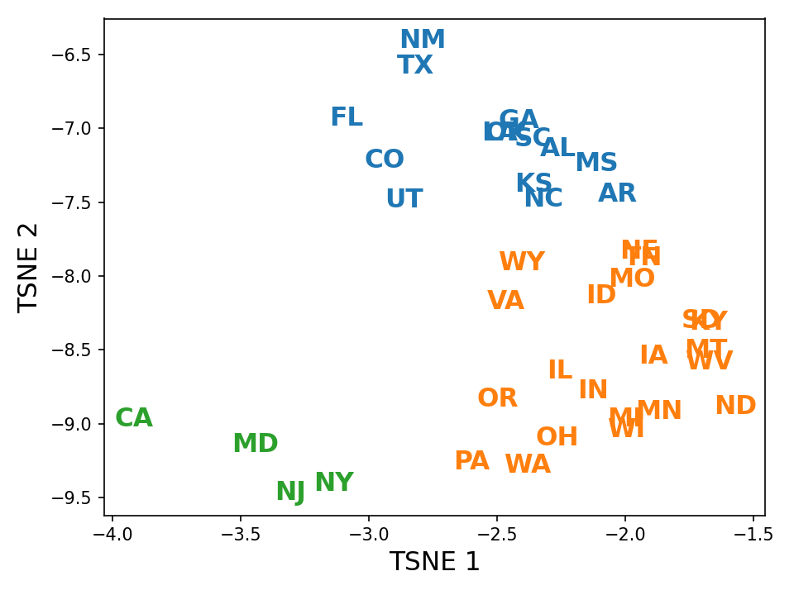
Varying state responses
We can calculate SHAP values for each state and cluster them by behaviour​
Poorer
Less dense
More diverse
Sunnier
Higher incentives
GHI contributes more
Richer
More racially diverse
More democratic
A lot denser
Income and density contribute more
Less diverse
Less sunny
Lower incentives
GHI contributes less

Slide 9
Time series anylsis

Slide 10
Limitations and Future work​
Data is from 2016​
Could split into presence of solar panels or not and fit two models:​
  One to predict presence of solar panels​
  Another to predict the number of solar panels when they are present​

Slide 11
Conclusion

